Slide 1


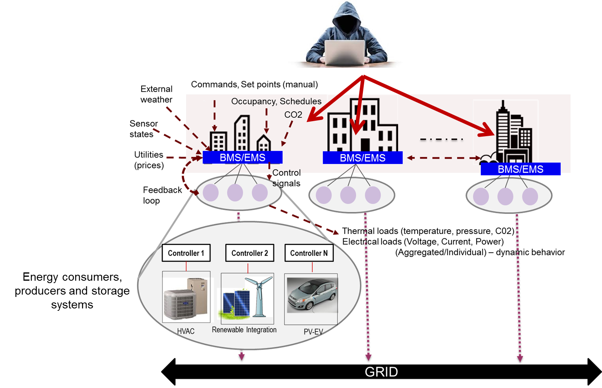

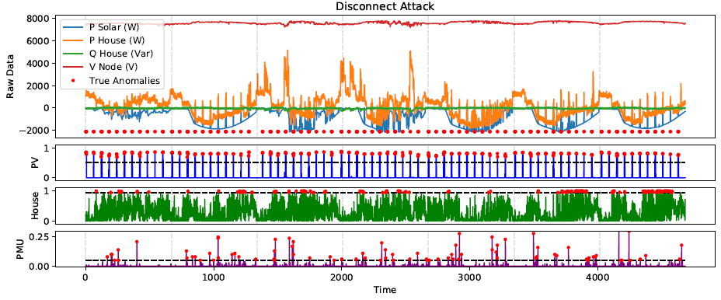
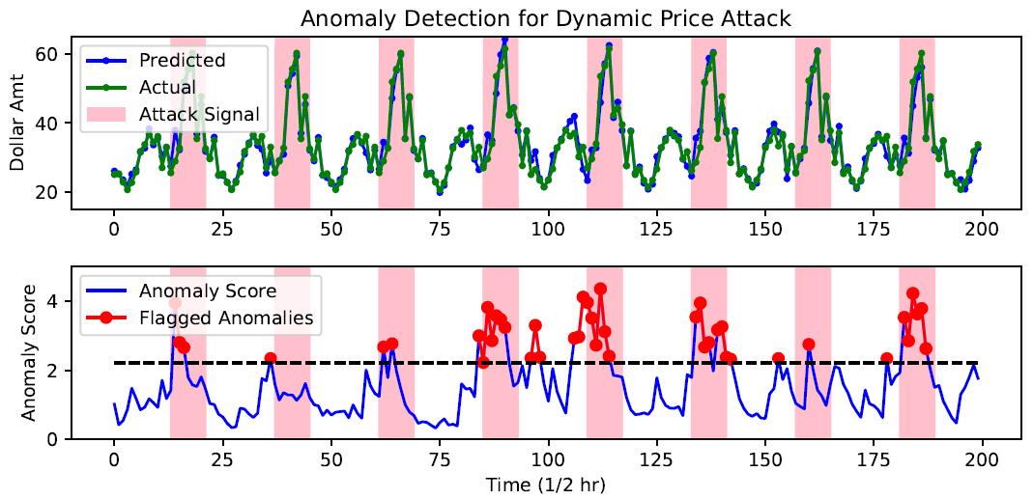
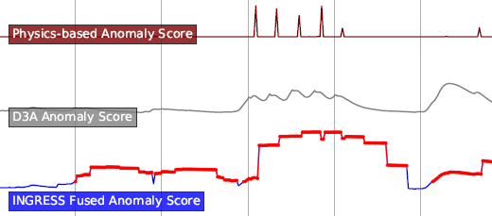
INGRESS…Integration of Green Renewable Energy Sources Securely with Buildings and Electric Power systems
Devu Manikantan Shila (PI) - UTRC, Mike Mylrea - PNNL, Jereme Haack - PNNL, Tim Yardley - UIUC, Sibin Mohan - UIUC
Challenges:
Problem Statement
System Model:
System & Adversary Model
Several attacks are already witnessed on smart edge systems
Malware attacks and energy theft attacks in smart meters; remote attacks on HVAC systems
Large scale attack possible by compromising multiple edge technologies
Interoperability with back end systems and supporting legacy systems is an issue
A group of N buildings with controllable loads which are classified into three types:
Type I - Passive Controllable Load: Refrigerators, freezers, air conditioners, water heaters . . .
Type II - Active Controllable Load: Battery storage, EV . . .
Type III - Renewable Generation: Solar, wind . . .
State-of-the-art:
Adversary Model:
Encryption is not a panacea – especially legacy systems
Lack of techniques to detect:
Malicious control commands (correctly formatted and syntactically valid) to edge devices
Misbehaving controllers
Attacking central Building & Energy Management Systems (e.g., data integrity attack, or spoof malicious commands to DER controllers/device)
Random Attack & Strategic Attack
Attacking local controllers by modifying control inputs (e.g., sensor tampering via physical attack or Stuxnet attack via physical or cyber)
Packets from field network
(e.g., power quality sensors reporting energy/voltage/current)
Packets to/from control network
(e.g., supervisory controller to actuators)
INGRESS on INTEL NUC Platform
BACnet/Modbus
PACKET PARSING ENGINE
VOLTTRON PACKET FORWARDING ENGINE
Load, Power quality, Control Events
Packet forward decision
Stripped
Packet copy
Validator decides if packet can be forwarded back to control network
INGRESS
D3A
INGRESS
Validator
Management Network
(Alert concentrator)
External data
(Weather, Prices)
Adversary model- Targeting large scale attacks by controlling multiple grid edge systems
Visualized Results
(iii) Intelligent Buildings (Video Demo Shows Detailed Results )
(i) Residential Distribution System
(ii) Demand Response
INGRESS
Achievements
Publications
Bump-in the wire technology for legacy and future systems
Detects and prevents malicious control commands issued to various types of behind-the-meter equipment
Identifies threats emerging from edge devices due to malicious controllers/sensors
Interoperability with building and energy management systems, and utility operations
Enhanced utility operations and planning; secure DER integration to power systems
For residential distribution grid with high penetration of solar generations, our analysis shows a combination of three level models (PV, House, and PMU level) and ability to jointly detect various attacks with high accuracy.
For demand response program, our anomaly detection method is able to observe discrepancies in real time price and control data, thus revealing price and software attacks.
For intelligent buildings, we are able to establish a real-world testbed and implement our edge-based detection using both physical and statistical features of microPMU data (check video demo for detailed results).
D. Manikantan Shila, K. Lore, T. Wei, T. Lovett, Y. Cheng, Catching Anomalous Distributed Photovoltaics: An Edge-based Multi-modal Anomaly Detection, https://arxiv.org/abs/1709.08830
E-C. Mahmoud, K. Lore, D. Manikantan Shila, A. Surana. Physics-Based Features for Anomaly Detection in Power Grids with Micro-PMUs. IEEE ICC 2018 SAC Symposium Communications for the Smart Grid Track, 2018.
K. Lore, D. Manikantan Shila, L. Ren, Detecting Data Integrity Attacks on Correlated Solar Farms Using Multi-layer Data Driven Algorithm, IEEE CNS, 2018, under review
D. Manikantan Shila, et al., Edge-Based Anomaly Detection for Cyber Attacks Against Demand Response, under preparation.
UTC PROPRIETARY - Export Controlled - ECCN: XXXXX

